Slide 1

Automated slugging detection using machine learning
MSc Applied Computational Sciences and Engineering
Imperial College London
10/09/2019
Deirdree A Polak
CID: 00973185
Notes:
Hi! Before we start
- This is my assessment presentation, and focuses more on Data Sciences and software development rather than results for Wintershall Dea

Slide 2
Agenda
Automated slugging detection using machine learning
Project Overview and Objectives
Slug Detection Package
Conclusion and Next Steps
10th September 2019
Imperial College London

Slide 3
Project Overview & Objectives

Slide 4
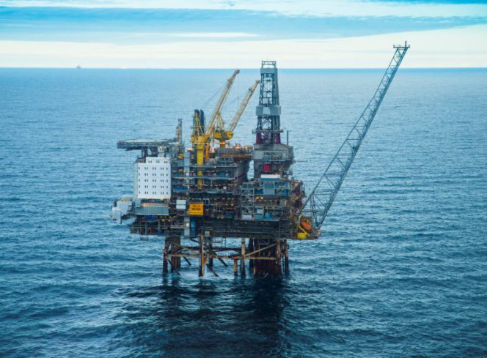
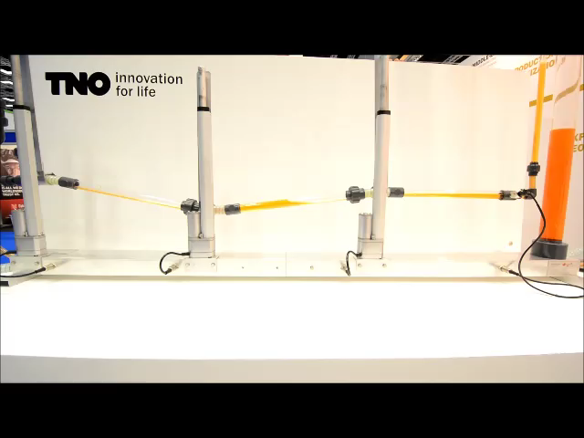

Offshore wells and Slugging
Automated slugging detection using machine learning
Notes:
Saturates separator ability to separate.
Harmful to production, so much so a certain well has been closed for a year

Slide 5
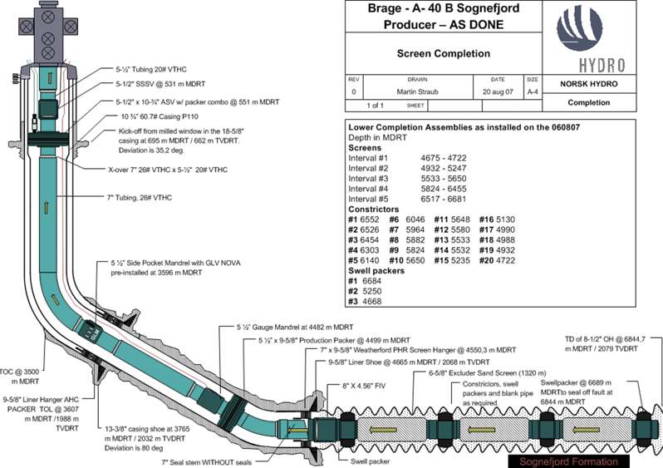
Data Available
Automated slugging detection using machine learning
Production Choke (WH choke) in %
Well Head Pressure (WHP) in BarG
Well Head Temperature (WHT) in C
Downhole Pressure (DHP) in BarG
Downhole Temperature (DHT) in C
10th September 2019
Imperial College London

Slide 6
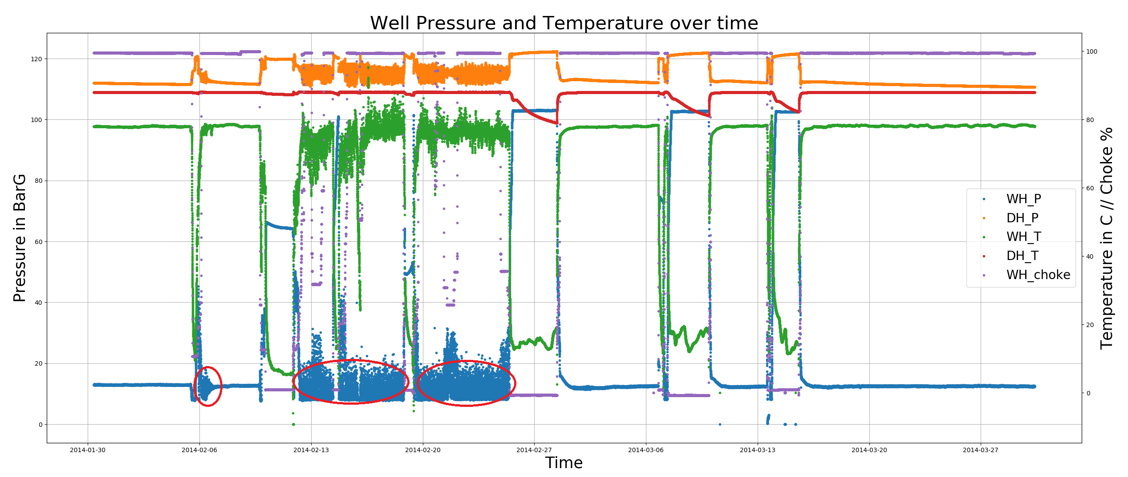
Slugging
Automated slugging detection using machine learning
10th September 2019
Imperial College London
Notes:
Add graphs annotation
X AXIS ?????

Slide 7
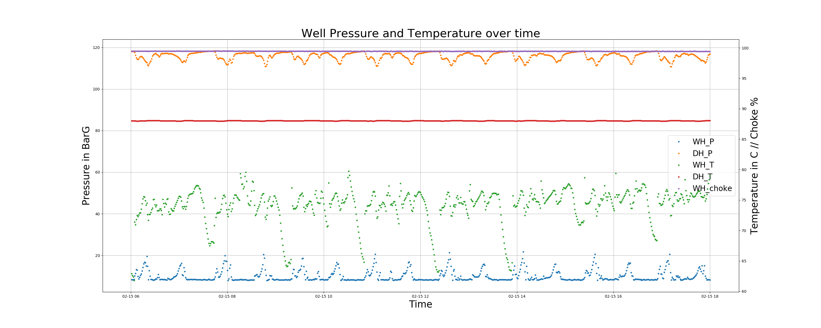
Slugging
Automated slugging detection using machine learning
10th September 2019
Imperial College London

Slide 8

Objectives
Automated slugging detection using machine learning
Clean the data available
Label the individual slug peaks in the data and/or slug flow
Train and tune model to recognize flow behaviours
Train and tune model on slug detection based on pre-slug flow and normal flow
Train and tune model to forecast slug flow
10th September 2019
Imperial College London

Slide 9
PACKAGE Description

Slide 10
Slug detection python package
slugdetection
Data Engineering
Slug Labelling
Slug Detection
Slug Forecasting
Flow Recognition
Overview

Slide 11
Data engineering
Automated slugging detection using machine learning
Data is out of range
Thresholding method with integrated threshold values
Set threshold values method
Closed choke and moving choke corrupt models and data
Clean choke method, above 99%
Clean choke method, above 5% and not transitioning
Slug behaviour and DHP range are changing over 10 years
Time range cropping method
Reset method
10th September 2019
Imperial College London

Slide 12

Slug Detection Python Package BUILD
Slug Labelling
Unsupervised Learning
Flow Recognition
Supervised Learning
Slug Detection
Supervised Learning
Feature Engineering
Slug Forecasting
Times Series Model
Automated slugging detection using machine learning
10th September 2019
Imperial College London

Slide 13
Slug Labelling
Automated slugging detection using machine learning
Objectives
Choked Flow
Machine Learning Technique
Unsupervised learning
K-Means Classification
Data Pre Processing
Feature vector:
Slug Flow
Pre - Slug after Choke
Cluster together and label flow portions as:
Clean choke of values below 99% open
Normal Flow
Pre-Slug formation
full data set
5, 20 and 40 minutes window
10th September 2019
Imperial College London

Slide 14
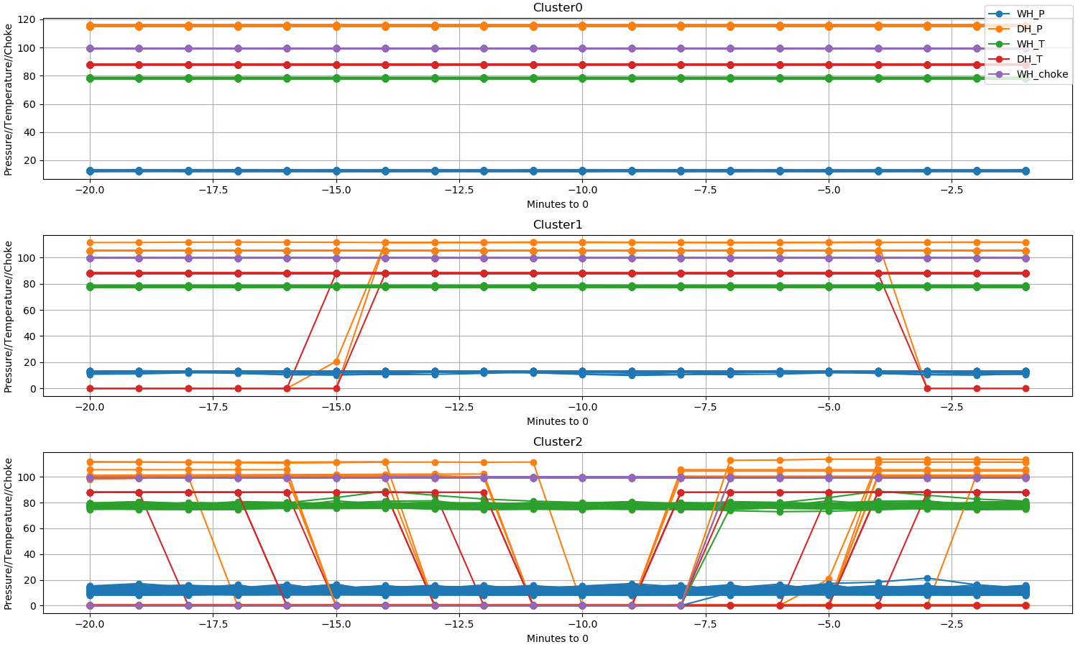
Slug Labelling Results
Automated slugging detection using machine learning
Feature Vectors: full data set for a 5, 20 and 40 minutes window
Lessons Learnt:
Unsupervised learning does not highlight slug or pre-slug behaviour
Choked behaviour results in discontinuity in the data, and heavily interferes with results.
WHP_0 | WHP_1 | WHP_2 | WHP_3 | … | WHP_20 | DHP_0 | …
10th September 2019
Imperial College London
Notes:
Just say don’t work, say can come back in questions

Slide 15
FLOW RECOGNITION
Automated slugging detection using machine learning
Objectives
Machine Learning Technique
Supervised Learning
Two Classifiers:
Data Pre Processing
Train and Tune a model to classify different flows:
Slug
First Slug
Pre-Slug flow
Normal flow
Else
Logistic Regression
Support Vector Machines (SVM)
Data Labelling
label = “slug” WHEN WHP differential > 3 BarG
label = ‘normal’ WHEN WH choke & WHP diff constant
Window labels are extrapolated from point labels
Feature vector:
full data set
5, 20 and 40 minutes window
Clean choke of values below 99% open
10th September 2019
Imperial College London

Slide 16
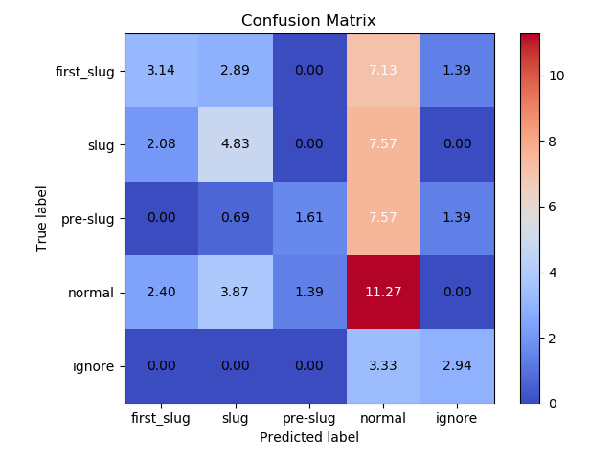
Flow Recognition Results
Automated slugging detection using machine learning
Lessons Learnt:
Labelling method is weak (normal flow over labelled)
Classifiers overwhelmed by number of labels
Feature vectors ineffective at reflecting flow qualities.
Logistic Regression Logged Results
10th September 2019
Imperial College London

Slide 17
Slug Detection
Automated slugging detection using machine learning
Objectives
Machine Learning Technique
Supervised Learning
Two Classifiers:
Data Pre Processing
Consider only continuous data where WH choke > 99%, and min time is 300 minutes
Train and Tune a model to classify:
Flow intervals leading to slug flow (True)
Flow intervals leading to normal flow (False)
Logistic Regression
Data Labelling
Slug Peaks
Random Forest
Deep Feature Engineering
First Slug
Intervals
10th September 2019
Imperial College London

Slide 18
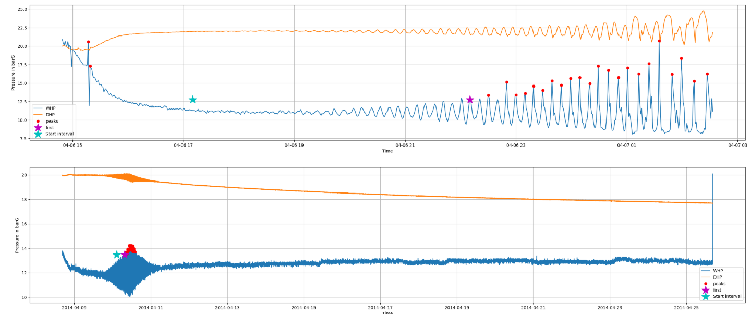
SLUG DETECTION Results - SLUG LABELLING
Automated slugging detection using machine learning
10th September 2019
Imperial College London

Slide 19
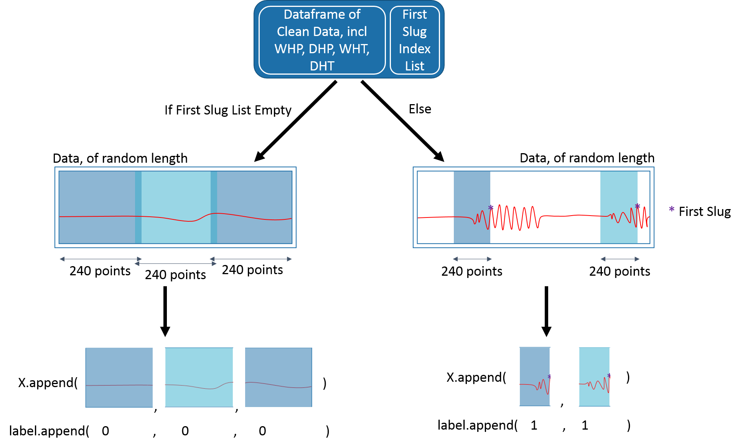
SLUG DETECTION – INTERVAL LABELLING
Automated slugging detection using machine learning

Slide 20
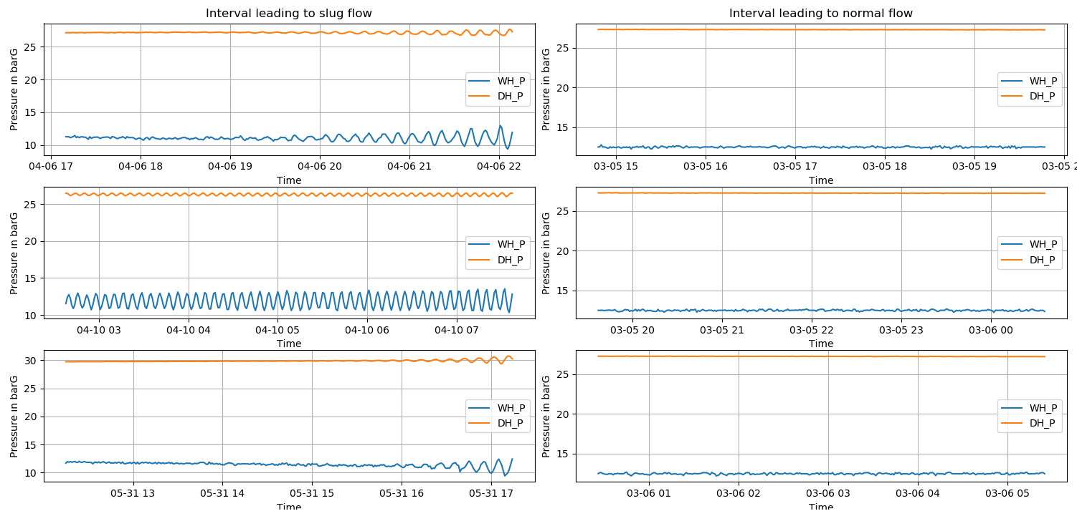
SLUG DETECTION RESULTS - INTERVAL LABELLING
Automated slugging detection using machine learning
10th September 2019
Imperial College London

Slide 21
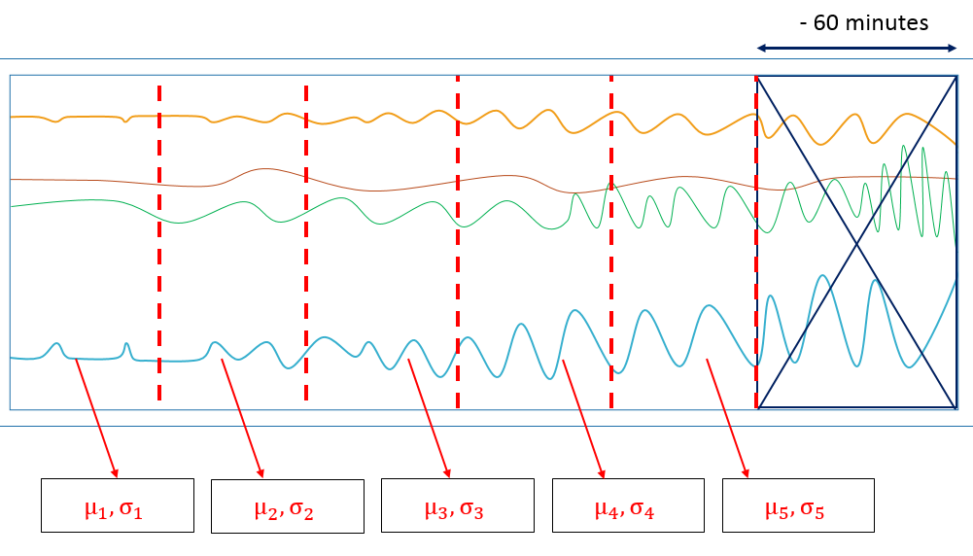
SLUG DETECTION – FEATURE ENGINEERING
Automated slugging detection using machine learning
10th September 2019
Imperial College London

Slide 22
SLUG DETECTION – FEATURE ENGINEERING
Automated slugging detection using machine learning
10 Features
8 Features
8 Features
8 Features
4 Features
18 Features
26 Features
34 Features
36 Features
Mean (normalised value) | Section 1
 | Section 2
 | Section 3
 | Section 4
 | Section 5
Standard Deviation (normalised value) | Section 1
 | Section 2
 | Section 3
 | Section 4
 | Section 5
Delta Mean | Section 1 - 2
 | Section 2 - 3
 | Section 3 - 4
 | Section 4 - 5
Delta Standard Deviation | Section 1 - 2
 | Section 2 - 3
 | Section 3 - 4
 | Section 4 - 5
Binary Increase Indicator Delta Mean | Section 1 - 2
 | Section 2 - 3
 | Section 3 - 4
 | Section 4 - 5
Binary Increase Indicator Delta Deviation | Section 1 - 2
 | Section 2 - 3
 | Section 3 - 4
 | Section 4 - 5
Binary Significance Indicator Delta Mean | Section 1 - 2
 | Section 2 - 3
 | Section 3 - 4
 | Section 4 - 5
Binary Significance Indicator Delta Deviation | Section 1 - 2
 | Section 2 - 3
 | Section 3 - 4
 | Section 4 - 5
Count number of significant increases | Mean
 | Std
Count number of significant decreased | Mean
 | Std
10th September 2019
Imperial College London

Slide 23
SLUG DETECTION – FEATURE ENGINEERING
Automated slugging detection using machine learning
10 Features
8 Features
8 Features
8 Features
4 Features
18 Features
26 Features
34 Features
36 Features
WHP + DHP + WHT + DHT
Total 152 features
10th September 2019
Imperial College London

Slide 24
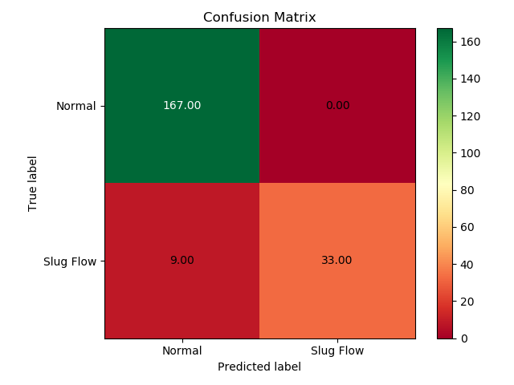
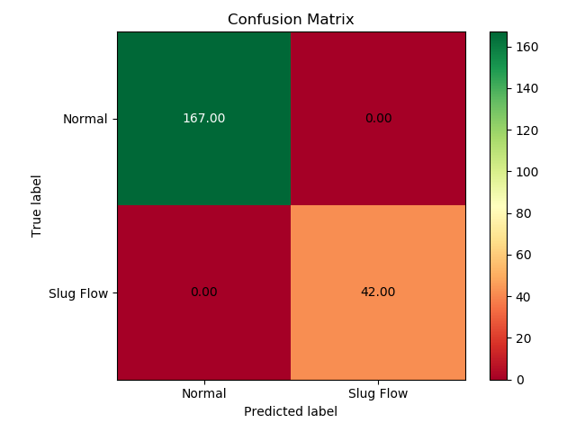
SLUG DETECTION RESULTS
Automated slugging detection using machine learning
Random Forest
Logistic Regression
ACCURACY RESULTS > 96%
10th September 2019
Imperial College London
ACCURACY RESULTS = 100%
Notes:
Results achieved after training hyperparameters

Slide 25
Slug FORECASTING
Automated slugging detection using machine learning
Objectives
Machine Learning Technique
Time Series Modelling
ARIMA Model
Data Pre Processing
‘Clean’ slugging interval lasting at least 240 minutes
Train model and forecast slug flow
10th September 2019
Imperial College London

Slide 26
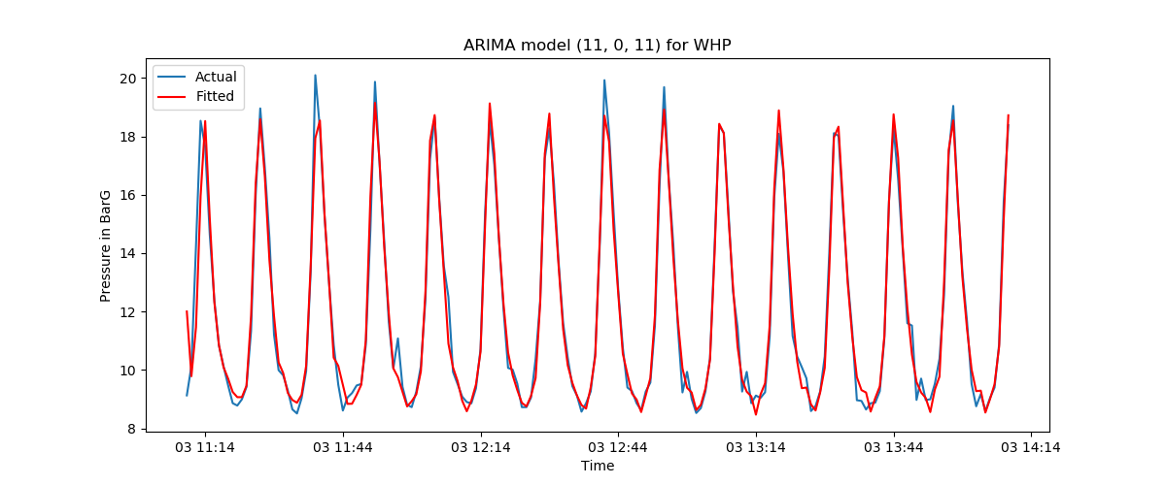
Slug FORECASTING RESULTS
Automated slugging detection using machine learning
10th September 2019
Imperial College London

Slide 27
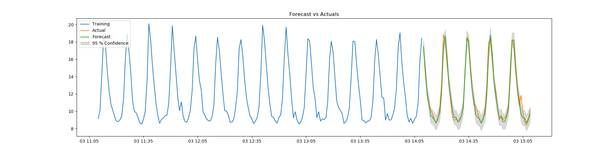
Slug FORECASTING RESULTS
Automated slugging detection using machine learning
10th September 2019
Imperial College London

Slide 28
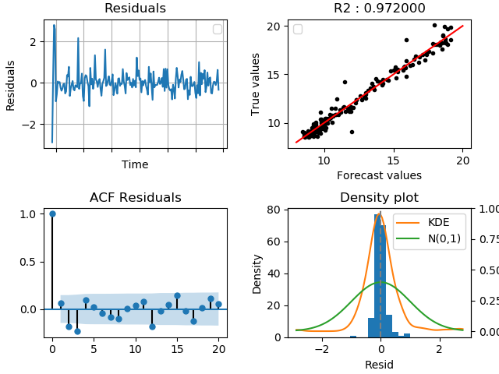
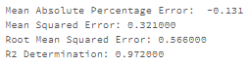
Slug FORECASTING RESULTS – Error metrics
Automated slugging detection using machine learning
10th September 2019
Imperial College London

Slide 29
conclusion

Slide 30
conclusion
Automated slugging detection using machine learning
slugdetection
Data Engineering
Slug Labelling
Slug Detection
Slug Forecasting
Flow Recognition
Slug Detection 60 minutes in advance is successful
Slug Forecasting is successful
Possibility to use feature engineering for Flow Recognition module
In the future:
Applying Slug Detection to live data
Using more complex Slug Forecasting model

Slide 31
Thank you for listening Questions?

Slide 32


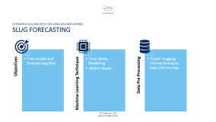

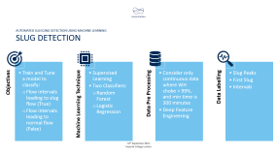
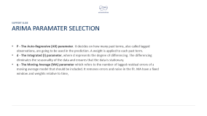
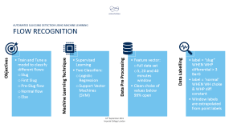
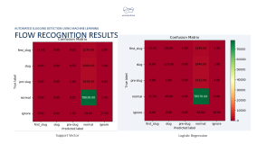
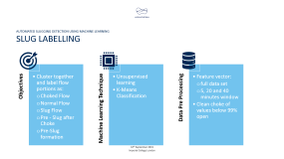
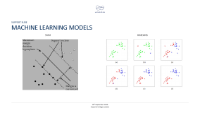

Slide 33
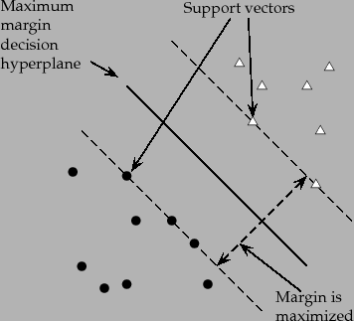
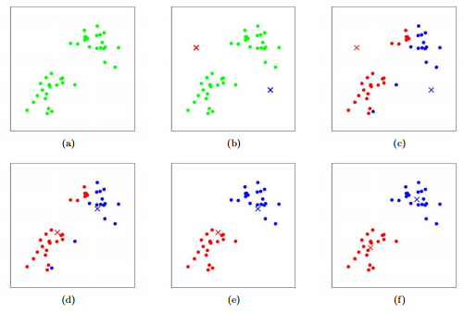
Machine Learning Models
Support Slide
SVM
KMEANS
10th September 2019
Imperial College London

Slide 34
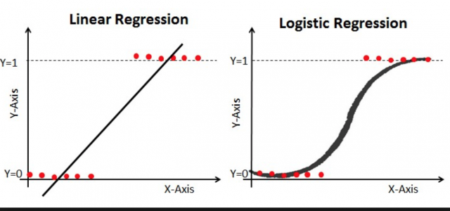
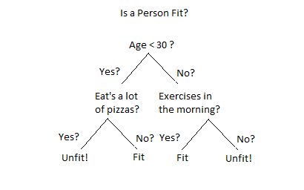
Machine Learning Models
Support Slide
Logisitic Regression
Random Forest/Decision Tree

Slide 35
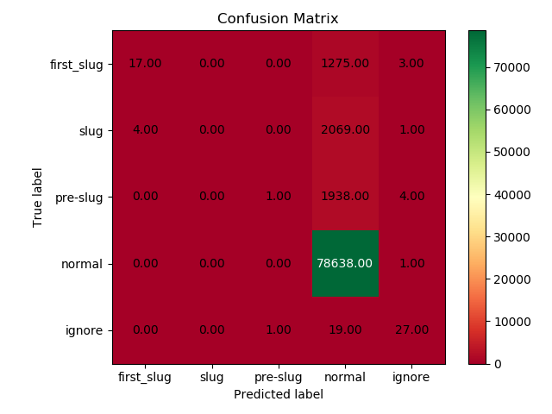
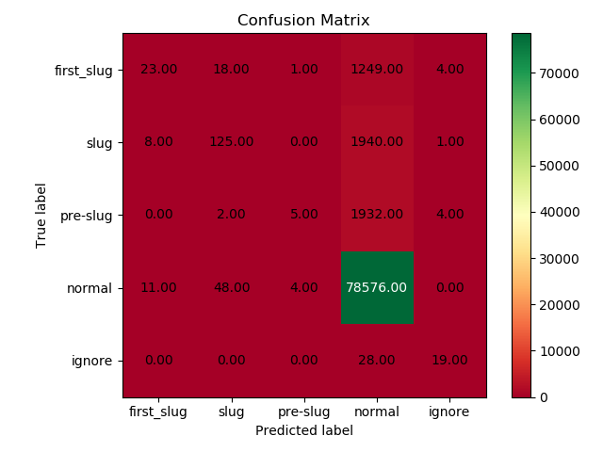
Flow Recognition Results
Automated slugging detection using machine learning
ACCURACY RESULTS > 95%
Support Vector
Logistic Regression

Slide 36
SLUG DETECTION – DATA LABELLING
SUPPORT SLIDE
Minimum 240 minutes since last first slug
Slug flow has not been continuous
Current and next two slug peaks are within 20 minutes each of each other
Current and next two slug peaks WHP are within 2 BarG each of each other
First Slug

Slide 37
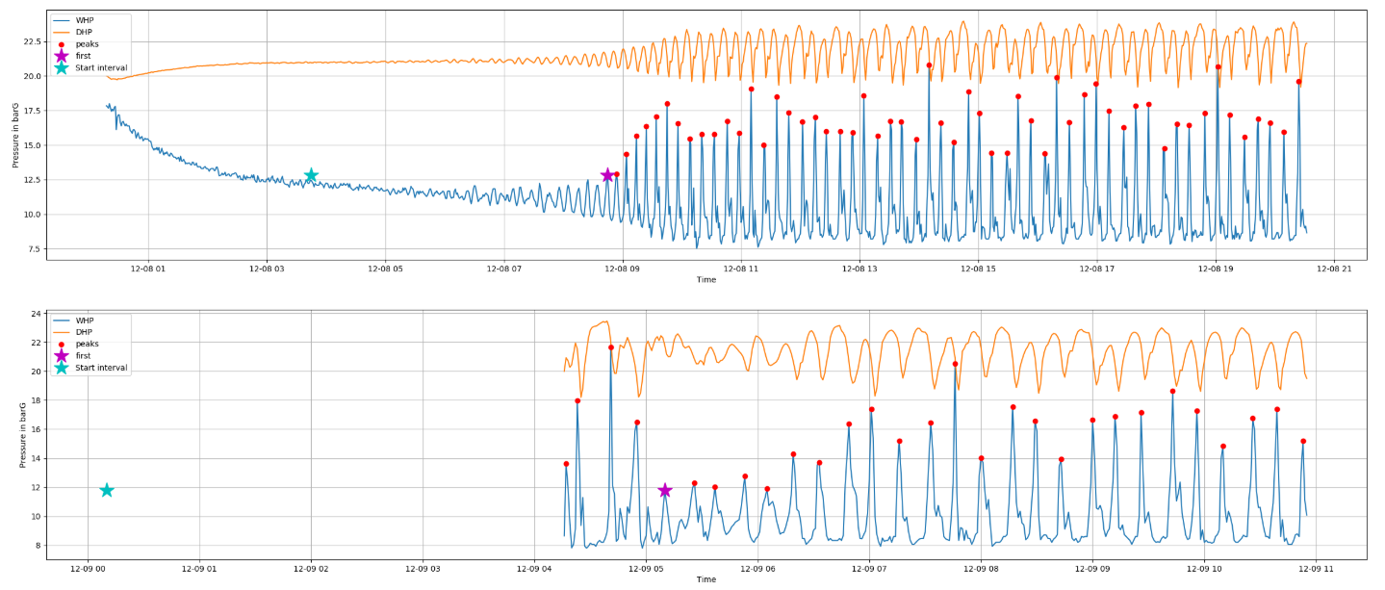
SLUG DETECTION Results (SLUG LABELLING)
SUPPORT SLIDE

Slide 38
TRAINING AND TUNING SLUG DETECTION
SUPPORT SLIDE
Include training and testing size
Show hyperparameter tuned

Slide 39
ARIMA PARAMATER SELECTION
SUPPORT SLIDE
P - The Auto-Regressive (AR) parameter. It decides on how many past terms, also called lagged observations, are going to be used in the prediction. A weight is applied to each past term.
d - The Integrated (I) parameter, where d represents the degree of differencing. The differencing eliminates the seasonality of the data and ensures that the data is stationary.
q - The Moving Average (MA) parameter which refers to the number of lagged residual errors of a moving average model that should be included. It removes errors and noise in the fit. MA have a fixed window and weights relative to time,

Slide 40
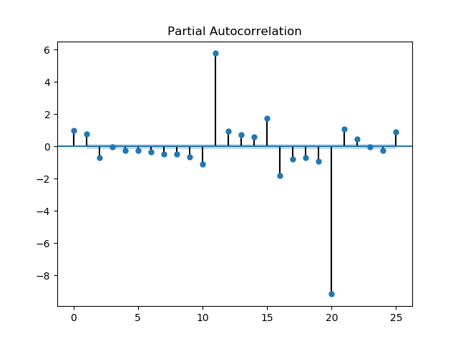
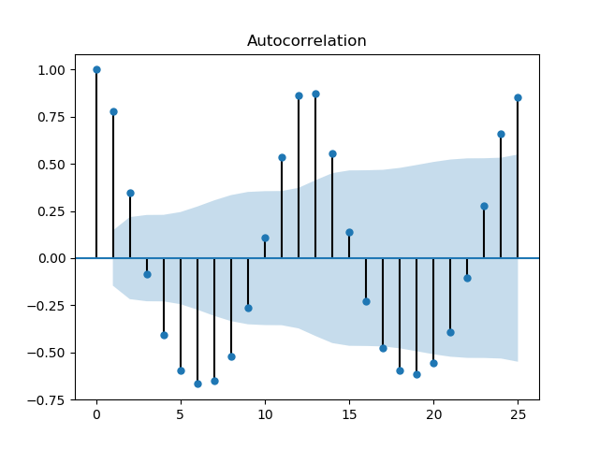
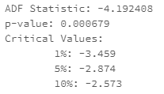
ARIMA PARAMATER SELECTION
SUPPORT SLIDE
p
d
q

Slide 41
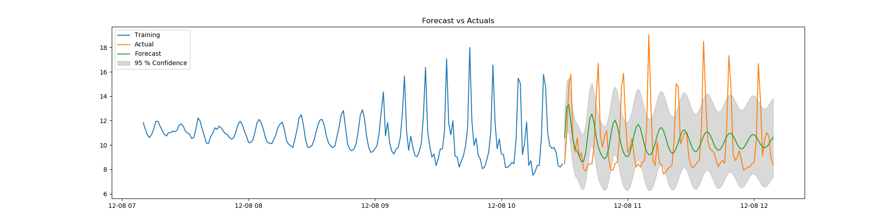
ARIMA Limitations
Support Slides

